Slide 1
ANRS 146 - GeSIDA 7211 OPTIMAL
Optimized Phase III Trial of Immuno-stimulation with Maraviroc, a CCR5 antagonist, combined with Anti Retroviral Therapy (cART) in advanced, Late diagnosed HIV-1 infected patients with an AIDS-defining event and/or CD4 counts ≤ 200 cells/mm³
Yves Lévy, Jean-Daniel Lelièvre, Lambert Assoumou, Esther Aznar, Federico Pulido, Giuseppe Tambussi, Manuel Crespo, Agnès Meybeck, Jean-Michel Molina, Fanny Cardon, Constance Delaugerre, Rémi Lancar, Lydie Béniguel, Dominique Costagliola and the OPTIMAL trial team

Slide 2
Conflict of interest disclosure
Fees for participation to board and serve as consultant: Gilead sciences
Invitation to international conference: No
Funding for research: No

Slide 3
Background
For many patients, HIV diagnosis is made late in the course of the disease (Immunodeficiency at the start of combination antiretroviral therapy in low-, middle- and high-income countries; Anderegg N. el al; IAS 2017)
Late HIV diagnosis is associated with an excess risk of AIDS-Defining-Events (ADE) and mortality
Several trials have failed to demonstrate in the past the clinical benefit of adding a 4th antriretroviral drug to standard 3-drug regimen in those patients.
We hypothesized that due to its immunomodulating effects, the addition of maraviroc (MVC) to cART in naïve patients with low CD4 cell counts will decrease the risk of disease progression and death

Slide 4
Design
HIV-1 infected patients with an AIDS-defining event and/or CD4 counts ≤ 200 cells/mm³; Naïve from any antiretroviral
1:1 randomization, double-blind,
stratification on the country and
treatment initiation regimen (PI vs non-PI)
ARV according to the recommended regimen in most commonly used guidelines + MARAVIROC
ARV according to the recommended regimen in most commonly used guidelines + Placebo
International: France, Spain and Italy,
Follow-up to week 72
FPFV: September 2011; LPLV: March 2016
Primary endpoint: Occurrence of a severe morbidity (AIDS, other HIV related diseases, serious non-AIDS events, IRIS and death)

Slide 5
Events considered as primary endpoint
New ADE (opportunistic events consistent with the 1993 CDC expanded surveillance definition plus additional events associated with immunosuppression in the patient population targeted for enrolment).
Non B or C:
- Opportunistic or severe uncommon infections: Aspergillosis invasive, Bartonellosis (includes bacillary angiomatosis and peliosis hepatis),Chagas disease (American trypanosomiasis) of the central nervous system, Leishmaniasis visceral (kala-azar), Microsporidiosis chronic intestinal (> 1 month's duration), Nocardiosis, Penicillium marneffei (extrapulmonary), Pneumocystis jiroveci (extrapulmonary,) Rhodococcus equi disease,
- Severe bacterial infections (sepsis with bacteremia requiring overnight hospitalization, or pneumonia requiring overnight hospitalization).
- Lymphomas: Lymphoma Hodgkin's, Lymphoma non-Hodgkin's (other cell type),
Serious non-AIDS events:
- Cardiovascular (myocardial infarction, stroke, coronary revascularization), Renal (Chronic end stage renal disease), and hepatic (Liver failure) diseases,
- Non-AIDS-defining cancers except basal and squamous cell skin cancers,
IRIS (according to M. French, AIDS 2004 revised Meintjes et al, lancet infectious diseases 2008).
All causes of mortality (related or not to AIDS).
All events were reviewed by an Event Review Committee

Slide 6
Enrolment and randomization
Screened (n=459)
Not-included (n=43)
42 had a non-inclusion criteria
1 refused to participate
Randomised (n=416)
Placebo arm (n=210)
207 took the treatment
3 never took the treatment
Maraviroc arm (n=206)
202 took the treatment
4 never took the treatment
Included in ITT analysis (n=207)
Included in ITT analysis (n=202)
Treatment stop (n=27)
1 lack of efficiency
9 adverse events
4 deaths
4 lost to follow-up
0 consent withdrawal
9 other reasons
Treatment stop (n=33)
0 lack of efficiency
6 adverse events
0 death
5 lost to follow-up
1 consent withdrawal
21 other reasons
Treatment until week 72 (n=180)
Treatment until week 72 (n=169)

Slide 7
Baseline characteristics (1/2)
 | PBO (n=207) | MVC (n=202) | Total (n=409)
Age, years, median [range] | 42 [21-74] | 42 [21-70] | 42 [21-74]
Male | 173 (83.6 %) | 174 (86.1 %) | 347 (84.8 %)
Sub-Saharan-Africa | 34 (16.4 %) | 27 (13.3 %) | 61 (14.9 %)
Men who have sex with men | 102 (49.3 %) | 104 (51.5 %) | 206 (50.3 %)
Baseline HIV VL, (log10) (cp/mL) | 5.5 [3.5-6.7] | 5.4 [1.9-6.7] | 5.4 [1.9-6.7]
<100,000 cp/mL | 54 (26.1 %) | 54 (27.0 %) | 108 (26.5 %)
100,000 -500,000 cp/mL | 88 (42.5 %) | 98 (49.0 %) | 186 (45.7 %)
>500,000 cp/mL | 65 (31.4 %) | 48 (24.0 %) | 113 (27.8 %)
R5 Tropism at D0†† | 144 (70.9%) | 123 (62.1 %) | 267 (66.6 %)
†† : 4 missing values in PBO group and 4 missing values in MVC group

Slide 8
Baseline characteristics (2/2)
 | PBO (n=207) | MVC (n=202) | Total (n=409)
CD4 cell count (/µL) | 85 [0-308] | 77 [3-236] | 80 [0-308]
<50/µL | 82 (39.6%) | 78 (38.6%) | 160 (39.1%)
50/µL-200/µL | 121 (58.5%) | 116 (57.4%) | 237 (58.0%)
>200/µL | 4 (1.9%) | 8 (4.0%) | 12 (2.9%)
CD4/CD8 | 0.12 [0-0.84] | 0.11 [0.01-0.56] | 0.11 [0-0.84]
<0.10 | 87 (42.2%) | 90 (45.0%) | 177 (43.6%)
0.10-0.30 | 99 (48.1%) | 91 (45.5%) | 190 (46.8%)
>0.30 | 20 (9.7%) | 19 (9.5%) | 39 (9.6%)
AIDS Defining Events at screening | 83 (40.1%) | 87 (43.1%) | 170 (41.6%)
Antiretroviral treatment
II based regimen | 33 (15.9%) | 29 (14.4%) | 62 (15.2%)
NNRTI based regimen | 32 (15.5%) | 32 (15.8%) | 64 (15.6%)
PI based regimen | 142 (68.6%) | 141 (69.8%) | 283 (69.2%)
Notes:
At enrolment, 9.5% of participants had been diagnosed HIV positive for <15 days, 40.9% for 15 days to 1 month, and 49.6% for >1month.

Slide 9
Primary endpoint and its components
Cox regression model adjusted for stratification factors
During the 72 weeks of follow-up, a total of 74 events were reported in 53 participants: 42 events in 27 participants in the Placebo group, and 32 events in 26 participants in the Maraviroc group

Slide 10
Sub-group analysis

Slide 11
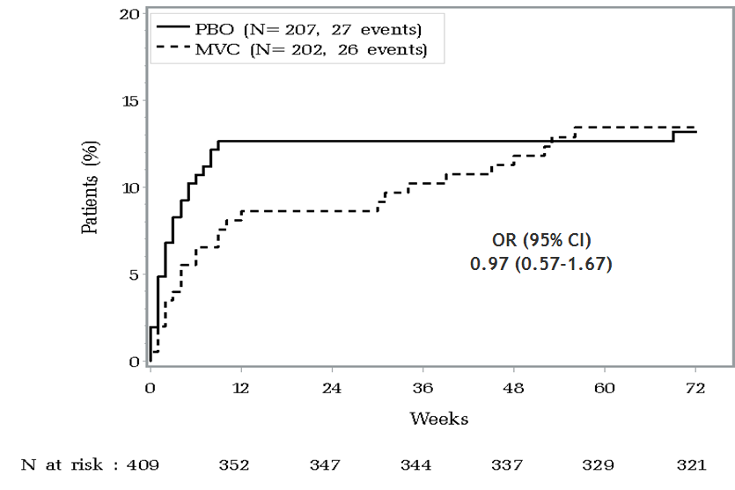
Kaplan-Meier curves for the Primary endpoints

Slide 12
Modifying effect on the incidence of events according to period (post hoc analysis)
Nb of events (Nb of pts)
MVC | PBO
31 (26) | 39 (27)
2,90
(95% CI: 0.86-12.49)
11 (10) | 4 (3)
0.61
(95% CI: 0.33-1.08)
20 (17) | 35 (26)
Interaction between group and period: p=0.016
MVC better
PBO better
Poisson regression model

Slide 13
Virological success
Snapshot method
76.3
75.4
78.3
72.0
60.9
71.3
72.8
66.3
67.3
57.9
P=0.048
P=0.207
29.0
30.2
15.5
5.3
12.4
3.0
failure = HIV RNA> 50 c/mL at assessment visit or withdrawal from the trial

Slide 14
Evolution of CD4 T cell count
+258
+254
P=0.746
Linear mixed model

Slide 15
Safety
154 SAE for 110 patients:
  Placebo group: 80 SAE for 52 patients. 8 are considered as related to the treatment by the investigator or the sponsor
  MVC group: 66 SAE for 51 patients. 25 are considered as related to the treatment by the investigator or the sponsor
  8 SAE for patients who never took the trial treatment.
4 pregnancies were reported during the trial (3 in PBO arm and 1 in MVC arm). No neonatal pathologies were reported.
4 patients of the Placebo arm died during the trial. No death in the MVC arm.

Slide 16
Conclusions
  Adding maraviroc to standard combined antiretroviral therapies during 72 wk in HIV-1 infected individuals diagnosed at a late stage had no impact:
  on the risk of occurrence of infections / serious events or mortality
  on virological control or CD4 T cell restoration
A post hoc analysis showed that maraviroc might have had a beneficial effect on the occurrence of clinical events during the first 6 months of use, which subsequently disappeared.

Slide 17
Acknowledgments (1/2)
France: Inserm U1136
Spain: Fundación SEIMC-GeSIDA (Madrid)
Italy: San Raffaele Scientific Institute (Milano)
Funders: Inserm-ANRS and Pfizer-ViiV Healthcare. ViiV donated drugs.
Trial Coordinating Committee: Y. Lévy (chair), JD Lelièvre (co-chair),
D. Costagliola, E. Aznar, F. Pulido, L. Assoumou, G. Tambussi,
C. Delaugerre, J. Izopet, G. Peytavin, C. Lacabaratz, J. Capeau,
Y. Yazdanpanah, L. Béniguel and ANRS (S. Couffin-Cadiergues,
F. Cardon, A. Diallo, S. Gibowski)
Event Review Committee: JD Lelièvre, A. Antela, S. Gallien,
G. Breton, J. Gasnault, JP. Spano, F. Boccara
DSMB: A. Phillips (chair), S. Moreno, G. Carcelain,
F. Ceccherini Silberstein, A. Volny-Anne, O. Lortholary

Slide 18
Acknowledgments (2/2)
We thank all the patients and staff from all the centres participating in the ANRS 146 OPTIMAL trial
Participating Centres:
FRANCE: CHIV (Villeneuve St Georges); Hôpital Necker (Paris); Hôpital de Bicêtre (Le Kremlin-Bicêtre); Hôpital Raymond Poincaré (Garches); Hôpital Avicenne (Bobigny); Hôpital Foch (Suresnes); Hôpital Henri Mondor (Créteil); Hôpital Pitié-Salpêtrière (Paris); Hôpital Saint-Antoine (Paris); Hôpital Saint-Louis (Paris); Hôpital Saint André (Bordeaux); Hôpital Sainte Marguerite (Marseille); Hôpital Bichat (Paris); CHU Montpellier, CHU Hôtel Dieu (Nantes); Hôpital de l’Archet (Nice); Hôpital Pontchaillou (Rennes); Nouvel Hôpital civil (Strasbourg); Hôpital de Purpan (Toulouse); CHU Dijon; Hôpital Gustave Dron (Tourcoing); Hôpital Croix Rousse (Lyon); CHIC (Créteil); Hôpital Hôtel Dieu (Paris)
SPAIN: Hospital Universitario La Paz (Madrid); Hospital Universitario 12 de Octubre (Madrid); Hospital Clinico San Carlos (Madrid); Hospital de la Santa Creu y Sant Pau (Barcelona); Hospital Infanta Leonor (Madrid); Hospital Príncipe de Asturias (Madrid); Hospital General (Granollers); Hospital La Fe (Valencia); Hospital General Universitario (Alicante); Hospital General Universitario (Elche); Hospital Xeral Cíes (Vigo); Hospital Donostia (San Sebastián); Hospital Virgen de la Victoria (Malaga); Hospital Universitario Virgen de las Nieves (Granada); Hospital de Basurto (Bilbao); Hospital Universitario Germans Trias i Pujol (Barcelona); Hospital Universitario Son Espases (Mallorca); Hospital Clinic i Provincial (Barcelona); Hospital Clínico Universitario (Valencia); Hospital Universitario Vall d´Hebrón (Barcelona)
ITALY: Hospital San Raffaele (Milano); Hospital L. Sacco (Milano); Hospital S. Anna (Ferrara); Hospital S.M. Annunziata (Firenze); Hospital Universitario San Martino (Genova)

